Slide 1
Smeal Student Society
Welcome Back Meeting
1/22/14

Slide 2
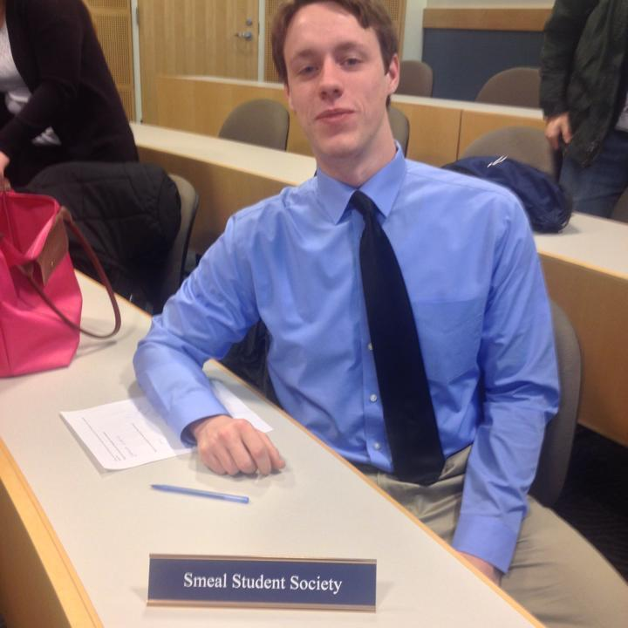
Nate Miller (President)
Sophomore
Applying for the MAcc with a minor in LER
Hometown is Chicago
Been living in SC since 2004
Die hard Pittsburgh fan (not Pitt)
Favorite show is either Breaking Bad or Lost

Slide 3
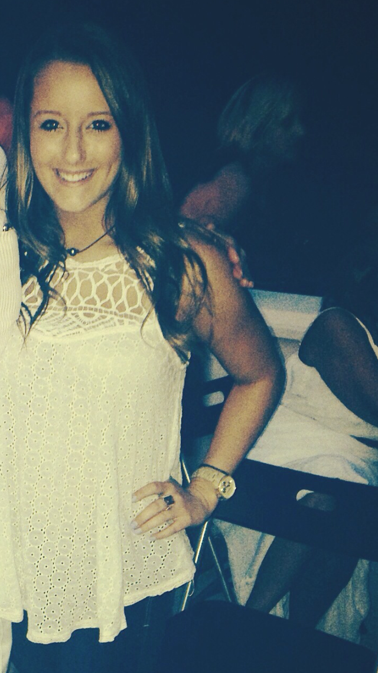
Alexa Parrish
(Faculty & Alumni Relations)
Sophomore
Hometown: Doylestown, PA
Intended major in Marketing, Spanish minor
HUGE Harry Styles fan

Slide 4
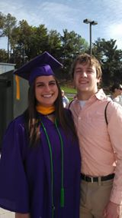
Brad Wilson (Events & Operations)
Sophomore
From York, PA
Intended Majors in Supply Chain and LER
Baltimore sports fan
Own a piece of the San Antonio Spurs

Slide 5
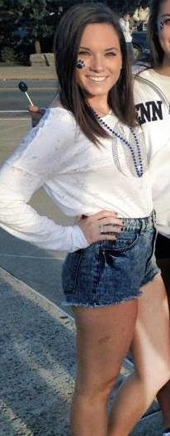
Sophie Meisenzahl
(Membership Affairs)
Sophomore
Hometown:Doylestown,PA
Intended Marketing major
Minor in Biology
Obsessed with Vine

Slide 6
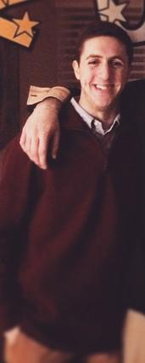
Dustin Tabor (Treasurer)
Second Semester Sophomore
Hometown: Princeton, NJ
Intended Marketing Major
Big New York Knicks fan

Slide 7
Icebreaker

Slide 8
Chair Positions (More info next GBM)
Corporate Chair
Faculty Spotlight Chair
Tour Chair
Fundraising Chair
Events Chair
Marketing Chair

Slide 9
Dues:
$15 for the semester
Money will be collected as soon as possible
Dues must be paid in order to remain an active member

Slide 10
Possible Events
Philanthropy
High School Visits
THON (for next year)
Fundraising
Five Guys’ (or other local restaurant)
Bowling
Social
Creamery
March Madness

Slide 11
Active Membership
15 points
Earn points by attending meetings, events, etc.
3 tour requirement

Slide 12
Student Acceptance Days
The first Accepted Students Day will be Friday, February 13th
We will need help from all of you
Also be sure to sign up for general tours on the doodle
**If you need to cancel a tour you must take your name off the doodle AND email me 24 hours in advance**

Slide 13
The Big Event
Tuesday, January 22
We don’t need help but SPREAD THE WORD!

Slide 14
Look out for emails from Alexa regarding to tours and thanks for coming out!

